Slide 1
Shell Lab 1
by Ethan Hurst

Slide 2
This presentation is NOT a replacement for reading the specs! If you haven’t read them yet, GO READ THE SPECS!

Slide 3
Important concepts:
(Stuff you should definitely read up on/google if you don’t understand)
Fork()/Execve()
Pipe()
Dup2()

Slide 4
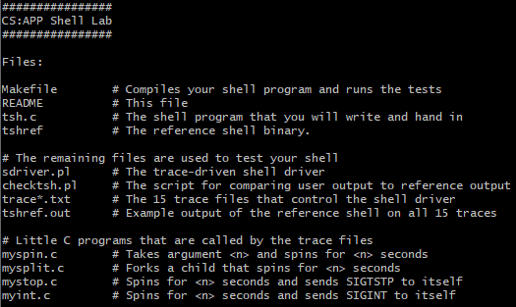
Step 1: Download shlab-handout.tar from Learning Suite

Slide 5
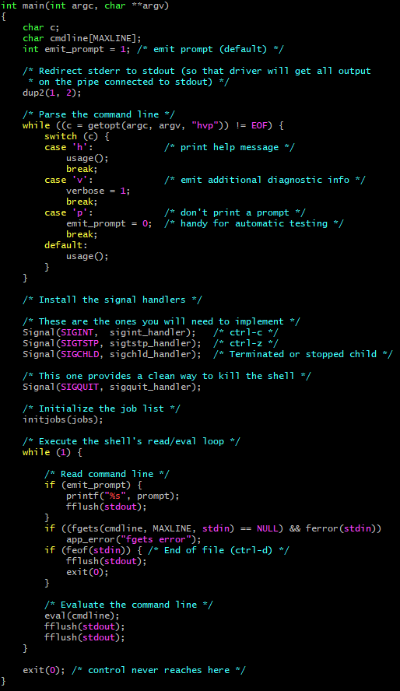
Step 2: Analyze the code you’re given
The main function is a good place to start understanding the code you’re given
The next few slides will go over the important bits

Slide 6
Step 2: Analyze the code you’re given
Notice the options available for starting the shell

Slide 7
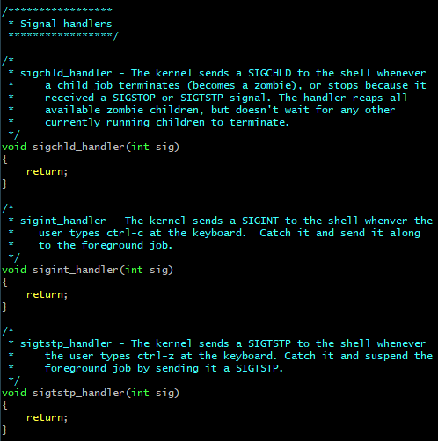
Step 2: Analyze the code you’re given
This is where the signal handlers are created
After this point, the handlers are now “listening” for their respective signals to be received
The only signal handler you need to worry about is sigchld_handler()

Slide 8
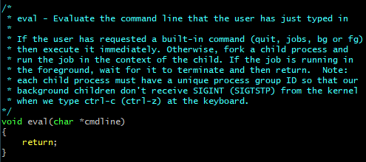
Step 2: Analyze the code you’re given
fgets() reads a string from a stream (stdin) until either:
An escape character such as ‘\n’ or ‘\d’ is reached
MAXLINE characters have been read
Once the command line has been read, eval() is called to evaluate the string
This is where the majority of the work for this project will be done

Slide 9
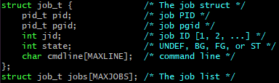
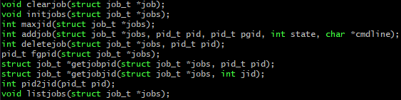
Step 2: Analyze the code you’re given
A (optional) small part of this lab will be managing the job list
If you choose to, adding/deleting jobs is all you will have to worry about
All of the functions for managing the job list are provided for you

Slide 10
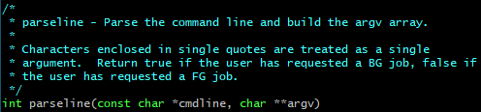
Step 3: Parse the command line
In order to figure out what to do with our input, we first have to parse it into discrete arguments
By a miraculous coincidence, there is a function that does exactly that!
It even tells you if the command should be run in the background!
All it needs is a buffer to modify, I suggest something like this:
argv
0
“Raw”
parseline()
1
“input”
“Raw input from command line”
2
“from”
3
“command”
4
“line”

Slide 11
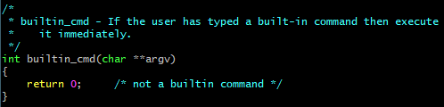

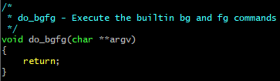
Step 3: Parse the command line
Now that we have an array of discrete arguments, we can check whether or not it is a built-in command (quit, jobs, bg, fg)
If it is a built-in command, it should be executed immediately, skipping over everything else
Hint: if(!strcmp())
0
“myspin”
1
“20”
0
“quit”
This function is already implemented for you
0
“jobs”
0
“bg”
1
“1”
This is a function you will implement in the next lab

Slide 12
Step 3: Parse the command line
Now that you have an argv, you can use to figure out which commands need to be evaluated
You pass the argv array that was modified by parseline() as well as empty arrays for int *cmds, int *stdin_redir, and int *stdout_redir to parseargs()
cmds are the indexes for the command names that need to be evaluated
stdin_redir are the indexes for the input file names of the their respective commands
stdout_redir are the indexes for the output file names of the their respective commands
argv
cmds
argv
0
“/bin/cat”
0
0
0
“/bin/cat”
1
“<”
1
4
1
“NULL”
cmdline
2
“input.txt”
stdin_redir
2
“input.txt”
parseline()
3
“|”
parseargs()
0
2
3
“NULL”
“/bin/cat < input.txt | /bin/grep [a-z] > output.txt”
4
“/bin/grep”
1
-1
4
“/bin/grep”
5
“[a-z]”
stdout_redir
5
“[a-z]”
6
“>”
0
-1
6
“NULL”
7
“output.txt”
1
7
7
“output.txt”
returns: 0 (background status)
returns: 2 (# of commands)

Slide 13
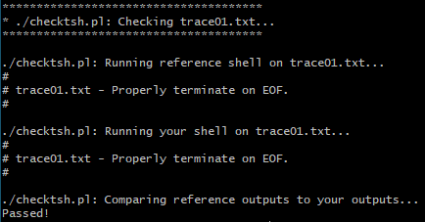
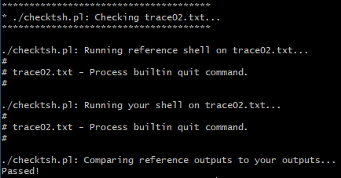
Test what you have!
At this point you should be able to pass test01 (end of file) and test02 (quit)
Type “make test01” and “make test02” to run the test

Slide 14
Step 4: Evaluate commands in a loop
At this point, you’ve parsed the command line and you know how many commands need to be evaluated
Before you worry about pipes and out/in redirection, focus on evaluating commands in a loop
This won’t behave correctly for more than one command until you implement pipes though
For each command
Fork
Child
Execute the command
Parent
Is this the first command?
Yes
Save the child’s pid
No
We want all the commands in a pipeline to have the same group id so that when we send a signal, it stops or pauses ALL the commands in the pipeline (this will be important next lab)
Set the group id of the current child to the pid of first command

Slide 15
Step 4: Evaluate commands in a loop
Execve() needs the name of a command and a pointer to an array of arguments:
http://man7.org/linux/man-pages/man2/execve.2.html
For this lab, you don’t need to create a new array of arguments, you can just give execve() a reference to an index in argv[]
The environment pointer can just be NULL
0
“/bin/cat”
1
NULL
2
“input.txt”
3
NULL
argv[cmds[i]]
4
“/bin/grep”
&argv[cmds[i]]
5
“[a-z]”
6
NULL
7
“output.txt”

Slide 16
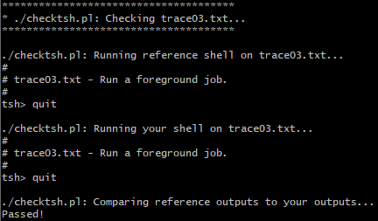
Test what you have!
Now that you can execute commands, you should be able to pass test03 (foreground job)
Type “make test03” to run the test

Slide 17
Step 4.5: Add job, waitfg, and sigchld_handler (Optional)
This step is not required to pass this lab, but I highly recommend you do it to get ahead on next week’s lab (this step shouldn’t be more than 15 lines of code)
Now that you can execute commands in a loop, you need to prevent the user from entering new commands until all of the previous one are finished
Here is an example of a command pipeline that a user has entered
The pid’s and pgid’s are arbitrary, and will be different every time you run your program
tsh> cmd0 | cmd1 | cmd2
Shell
pid 4398
pgid 2222
cmd0
pid 1234
pgid 1234
cmd1
pid 5678
pgid 1234
cmd2
pid 9012
pgid 1234
cmd0
pid 1234
pgid 1234
cmd1
pid 5678
pgid 1234
cmd2
pid 9012
pgid 1234
Shell
pid 4398
pgid 2222
cmd0
pid 1234
pgid 1234
cmd1
pid 5678
pgid 1234
cmd2
pid 9012
pgid 1234
Shell
pid 4398
pgid 2222
Running
Waiting
Finished
But how can you tell the shell to unpause after the last command if it’s running in a different process? With signals!
We need a way to pause the shell until the last command in the pipeline has finished running
Because the shell is still running, the user is still able to enter new commands while the previous ones are still running. This is a problem!
Notice how all of the commands in the pipeline have the same parent group id as the first command
Right now, if you were to run a pipeline like this in your shell, all of the commands would execute at the same time.
Use presentation mode!

Slide 18
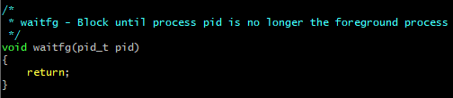
Step 4.5: Add job, waitfg, and sigchld_handler (Optional)
In this step, you will be implementing waitfg() and sigchld_handler()
Immediately after your loop, you need to add a SINGLE job to the jobs list with the information from the LAST command (the state of the job comes from parseline())
addjob() has already been implemented for you
Then you need to call waitfg() and pass it the process id of the LAST command in the pipe line
Is the pid the same as the foreground pid?
No
return
Yes
Sleep for 1 second

Slide 19


Step 4.5: Add job, waitfg, and sigchld_handler (Optional)
The purpose of sigchld_handler is twofold:
It reaps child processes once they’ve terminated (becoming a zombie)
It removes completed jobs from the job list
Running
Waiting
Finished
cmd1
pid 5678
pgid 1234
status alive
cmd1
pid 5678
pgid 1234
status zombie
Inside sigchld_handler(), you want to reap the child process using waitpid(): https://linux.die.net/man/3/waitpid
You’ll want to use the following options for waitpid():
pid -1 means you want to wait for any child (effectively making waitpid() behave like wait()),
WNOHANG means waitpid() will return immediately instead of blocking,
and WUNTRACED means stopped processes will be reaped
Since there may be more than one child process waiting to be reaped when sigchld_handler() is called, you need to call waitpid() in a loop until it returns something less than 0. By reaping and deleting jobs in a loop, you ensure that all zombie processes are reaped and no jobs are left unaccounted for.
Don’t forget to delete the job from the job list! This is how waitfg() will know that the current job is no longer in the foreground
What happens when 2 child processes finish at the same time? Signals behave like flags until they are handled, thus SIGCHLD will only be signaled once. This means that your shell will only be interrupted once, and only one of the processes will be reaped. This is a problem!
cmd0
pid 1234
pgid 1234
status alive
cmd0
pid 1234
pgid 1234
status zombie
Since it has been specified in main() that you want to handle all SIGCHLD signals, your shell will immediately jump to the sigchld_handler() from where ever it is, and the signal will be consumed
SIGCHLD
Shell
waitfg()
waiting on foreground job…
Shell
main()
waiting for user input…
Shell
sigchld_handler()
When a child process terminates or stops, a SIGCHLD signal is sent to the kernel
Use presentation mode!

Slide 20
Step 5: Input/output redirection
So far, when the shell fork()s a child, all the child does is execute its command
Before you call execve(), you should check stdin_redir[] and stdout_redir[] to see if the command has any input/output redirection
Hint: fileno()
stdin_redir[]
*argv[]
Does this command have any input redirections?
Yes
Open the specified file for reading
Duplicate the file descriptor over stdin
0
2
0
“/bin/cat”
No
1
-1
1
“NULL”
2
“input.txt”
3
“NULL”
Does this command have any output redirections?
Yes
Open the specified file for writing
Duplicate the file descriptor over stdout
4
“/bin/grep”
stdout_redir[]
5
“[a-z]”
No
0
-1
6
“NULL”
1
7
7
“output.txt”
Execute the command

Slide 21
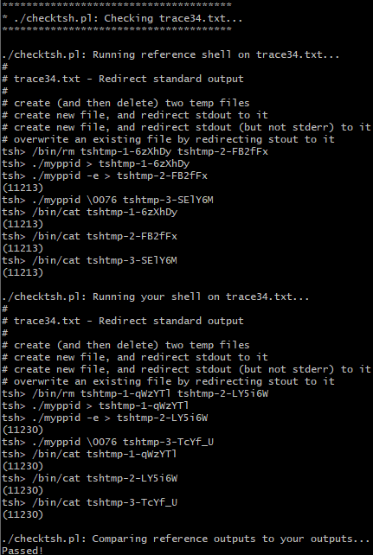
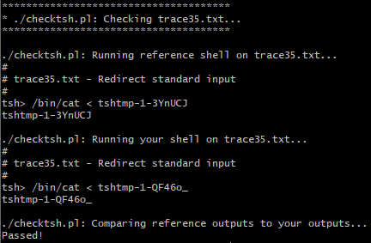
Test what you have!
With input/output redirection, you should be able to pass tests 34 and 35
Type “make test34” and “make test35” to run the tests

Slide 22

Step 6: Pipe output to input
This will most likely be the trickiest part of the lab for you (it was for me!)
I recommend reading up on how pipes work before you do this part
https://www.geeksforgeeks.org/pipe-system-call/
https://www.geeksforgeeks.org/c-program-demonstrate-fork-and-pipe/
tsh> cmd0 | cmd1 | cmd2
cmd1
pid 5678
pgid 1234
cmd2
pid 9012
pgid 1234
Shell
pid 4398
pgid 2222
Running
Waiting
Finished
cmd2
pid 9012
pgid 1234
Shell
pid 4398
pgid 2222
cmd1
pid 5678
pgid 1234
cmd2
pid 9012
pgid 1234
cmd0
pid 1234
pgid 1234
cmd1
pid 5678
pgid 1234
cmd0
pid 1234
pgid 1234
Now we need to send information from one command to the next. We can’t have all of the commands running independently of each anymore
So far, all the commands in a pipeline run independent of one another while the shell waits for the last one to finish
Use presentation mode!

Slide 23

Step 6: Pipe output to input
Since pipe management gets complicated in this lab, I’m going to show you how it works
iteration 0
iteration 1
iteration 2
Shell
Shell
0
Shell
0
0
Once again, the process forks and each process gets a copy of the pipes
On the next iteration, the shell creates a new pipe
The child process closes its read end (since it’s the first command in the pipeline) and duplicates stdout over the write end of the pipe
At the same time, the parent closes its write end, and saves the read end of its pipe for the next iteration
Again, the child closes the read end of the current pipe and duplicates stdout over the write end of the pipe, but this time it also duplicates stdin over the previous pipe
You can see there is a flow of information from the output of one child to the input of the next
On the last iteration, the shell doesn’t need to make another pipe
Finally, the child duplicates stdin over its previous pipe and the parent closes its previous
On iteration 0, the shell creates a pipe
The parent closes both the write end of the current pipe and read end of the previous pipe, as well as saving the read end of the current pipe for the next iteration
0
When the process forks, each gets a copy of the pipe
0
0
1
0
1
0
1
0
1
parent
Fork
child
parent
Fork
child
parent
Fork
child
0
1
0
1
0
0
0
0
stdin
stdout
stdin
stdout
0
1
0
1
stdout
Next
Execute
Next
Execute
Exit loop
Execute
Use presentation mode!

Slide 24
Step 6.5: Block signals at critical times (Optional)
The two most critical times where you DO NOT want signal interrupts to happen are:
In the command evaluation loop
When adding/deleting jobs
Slides 37 – 39 in the Chapter 8 (2) – Signals ppt on Learning Suite are very helpful here!
Block all signals
Make sure to unblock signals right before you execute the command, otherwise SIGCHLD won’t be signaled when the command is executed!
For each command
Fork
Unblock all signals
Execute command
Add job to job list
Make sure to unblock signals AFTER you add the job to the job lists, others you could be deleting a job before it has been added!
Don’t forget to block and unblock before/after you delete a job inside sigchld_handler(), signal handlers can be interrupted too!
Unblock all signals

Slide 25
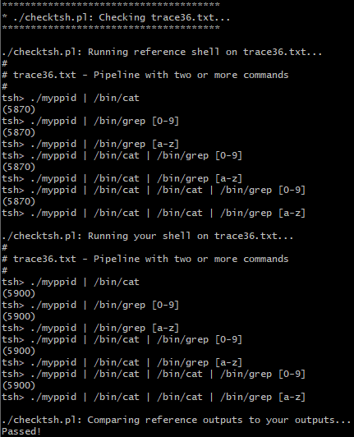
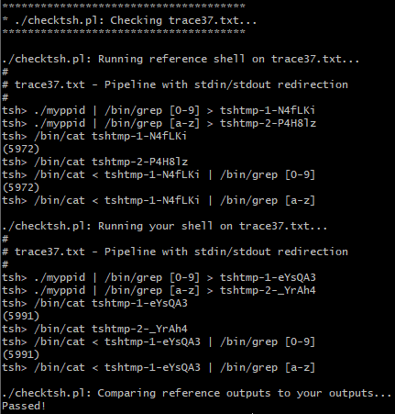
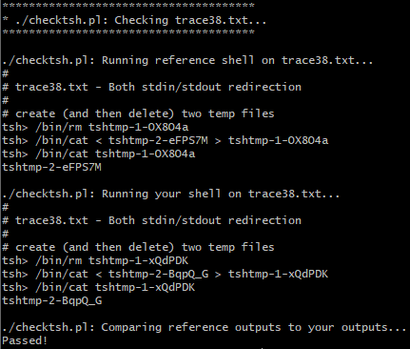
Test what you have!
That’s everything you have to do for this lab!
Type “make test36”, “make test37”, and “make test38” to run the rest of the tests

